Slide 1
Music Life in Universities

Slide 2
Why I choose this topic
Started fourth grade
Groups
Social circles
Met many musicians who had talents but wanted to continue education in another field

Slide 3
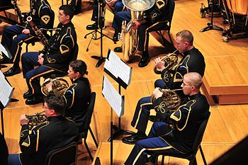
What can I do?
Music major/minor
Music ensembles
Music clubs
Notes:
There is always a place for students to fit in, no matter the skill level
Mention Sai and Kiran

Slide 4
Why?
The benefits of music
Academics
Exercising the brain
Research of Jane Aw Yang Huey: Economics
Mozart effect
Notes:
such as linguistics, logical mathematical, spatial, bodily kinesthetic, intrapersonal, and interpersonal intelligence
the Mozart effect is a phenomenon found when college students listen to an excerpt of Mozart--those students then demonstrated a temporary improvement in performance of spatial tasks
Mental
Academics
Memory improvement

Slide 5
Why?
The benefits of music
Others
Physical
Social
Mental
Spiritual
Notes:
Music has other beneficial effects other than academic. As put, music was valued primarily for its "role in the social, physical, moral, and intellectual development" (Bures). During the 1800's when the US put an emphasis on education, bands and orchestras grew in order to provide students with entertainment and social benefits, which improved students' attitudes toward learning, personal appearance, and attendance. Bures also found that music education at a college level promoted diversity, cooperative spirit, healthy lifestyle, and leadership skills. These statements are agreed with by Kokotasaki, who said those who participate in group music in college become active contributors, develop a strong sense of belonging, gain popularity, and encourage confidence and motivation. Huey said that music also increases energy levels, helping students become more aware in class. Music indeed does have diverse benefits that helps students enhance their physical, social, mental, and spiritual being.

